Slide 1
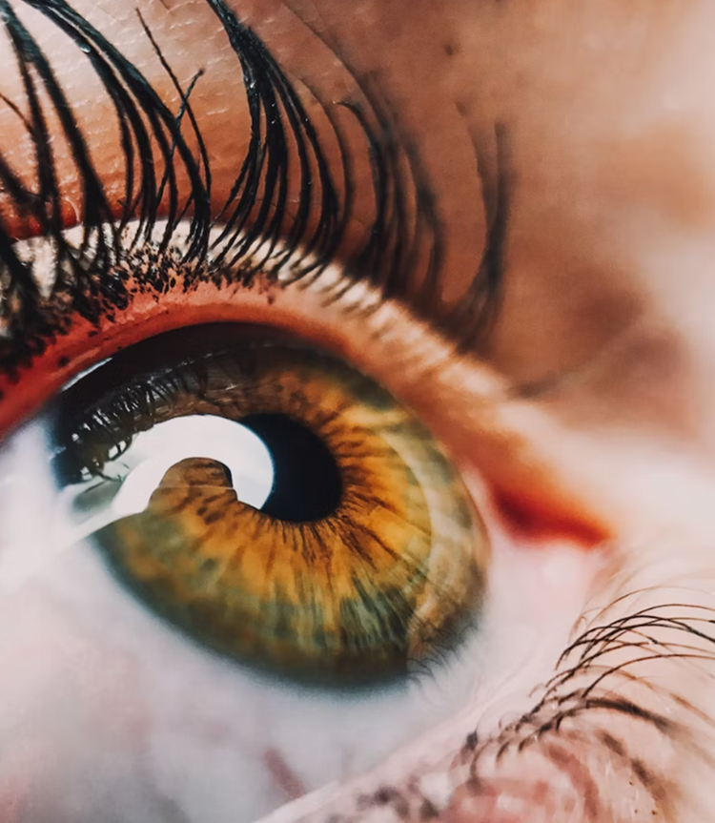
THIRD EYE
TEAM NO:4
TEAM MEMBERS: AKHIL SANKAR S
ALPHY GEORGE
IRENE MOLLY VARUGHESE
RINTA MARIA RAJU
GUIDED BY: PROF. THUSHARA SUKUMAR
ASSISTANT PROFESSOR
DEPT OF CSE

Slide 2
CONTENTS
Introduction
Problem Statement
Software and Hardware Requirements
Functional
Requirements
Conclusion
Presentation Title

Slide 3

PROBLEM STATEMENT
There are millions of visually impaired people worldwide who struggle with everyday tasks. Visually impaired individuals face significant challenges when it comes to navigating their surroundings independently and safely.
The absence of visual cues often leads to obstacles and hazards that can hinder their mobility and reduce their quality of life.
We aim to enhance the mobility and independence of visually impaired individuals by developing a wearable device that can be attached to their spectacles.

Slide 4
FUNCTIONAL REQUIREMENTS
Object Detection - TensorFlow , OV7670 Camera Module Or ESP32
Navigation - HC-SRO4 Ultrasonic Sensor
Text to Speech - Pyttsx 3
Real time auditory feedback

Slide 5
HARDWARE REQUIREMENTS
Arduino UNO R3 :Arduino UNO is a low-cost, flexible, and easy-to-use programmable open-source microcontroller board that can be integrated into a variety of electronic projects. This board can be interfaced with other Arduino boards, Arduino shields, Raspberry Pi boards and can control relays, LEDs, servos, and motors as an output.
OV7670 Camera Module :The OV7670 Camera Module is a small image sensor, with low operating voltage, providing all functions of a single chip of VGA camera and image processor.
HC-SRO4 Ultrasonic Sensor:HC-SR04 stands for High-Conductance Ultrasonic Sensor consists of a transmitter and receiver. The sensor measures how far things are without touching them, and it uses sound waves to get the measurements right. It can work well when things are between two to four centimeters away.

Slide 6
Smartphone with 8GB RAM and 218GB ROM - For real time auditory feedback
Laptop with 8 GB RAM (If laptop have graphics card performance can be improved)

Slide 7
SOFTWARE REQUIREMENTS
TensorFlow : It is an open source machine learning framework . The most popular version of TensorFlow is TensorFlow 2.0, which was released by Google in September 2019. It can be used in a wide variety of programming languages, including Python, JavaScript, C++, and Java
Pyttsx 3 : Unlike pyttsx 2, which supports only Python 2.x, pyttsx 3 is modified to work on both Python 2.x and Python 3.x with the same code. This makes it more versatile and adaptable to different Python environments.
ROI: Stands for Region of Interest, It refers to a specific area or region within an image that is of particular interest or importance. This region is usually defined by a bounding box or a polygon, and it is used to extract features or perform further analysis on the image.

Slide 8


CONCLUSION
The Third Eye is a groundbreaking project that has the potential to transform the lives of millions of visually impaired people around the world. We are proud to use our technical skills to create a practical and innovative solution that promotes independence and accessibility

Slide 9
REFERENCES
[1] H. Kohli and J. Agarwal, "Deep Learning based Object Detection and Recognition Framework for the Visually-Impaired," 2020 Fourth International Conference on Computing Methodologies and Communication (ICCMC), pp. 1-6, Mar. 2020, doi: 10.1109/ICCMC48092.2020.ICCMC-000135.
[2]P. Devika, S. P. Jeswanth, and B. Nagamani, "Object Detection and Recognition Using TensorFlow for Blind People," 2022 International Research Journal of Modernization in Engineering Technology and Science, vol. 4, no. 3, pp. 1-6, Mar. 2022, doi: 10.34218/irjmets.2022.v4n3p1.
[3]U. Masud, T. Saeed, H. Malaikah, F. Ul Islam, and G. Abbasi, "Smart Assistive System for Visually Impaired People Obstruction Avoidance Through Object Detection and Classification," IEEE Access, vol. 10, pp. 13428-13441, Jan. 2022, doi: 10.1109/ACCESS.2022.3158826.
[4] S. S. Singh, M. Agrawal, and M. Eliazer, "Collision detection and prevention for the visually impaired using computer vision and machine learning," IEEE Access, vol. 10, pp. 13428-13441, Jan. 2022, doi: 10.1109/ACCESS.2022.3158826.

Slide 10



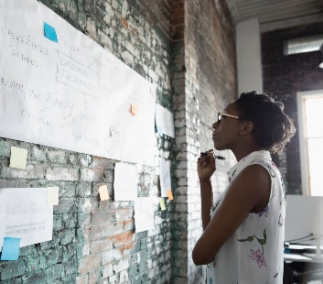
THANK YOU

